Slide 1


Exploring Canny tool - Main features - Introduction
Lazar Milicevic
Main features, showcase, integrations
13.02.2024

Slide 2
Agenda
1. Introduction to Canny
3. How We Can Use Canny
5. Key Benefits for the Product Team
7. Q&A
2. Why Canny for Owkin?
4. Understanding the Canny Portal
6. Conclusion

Slide 3
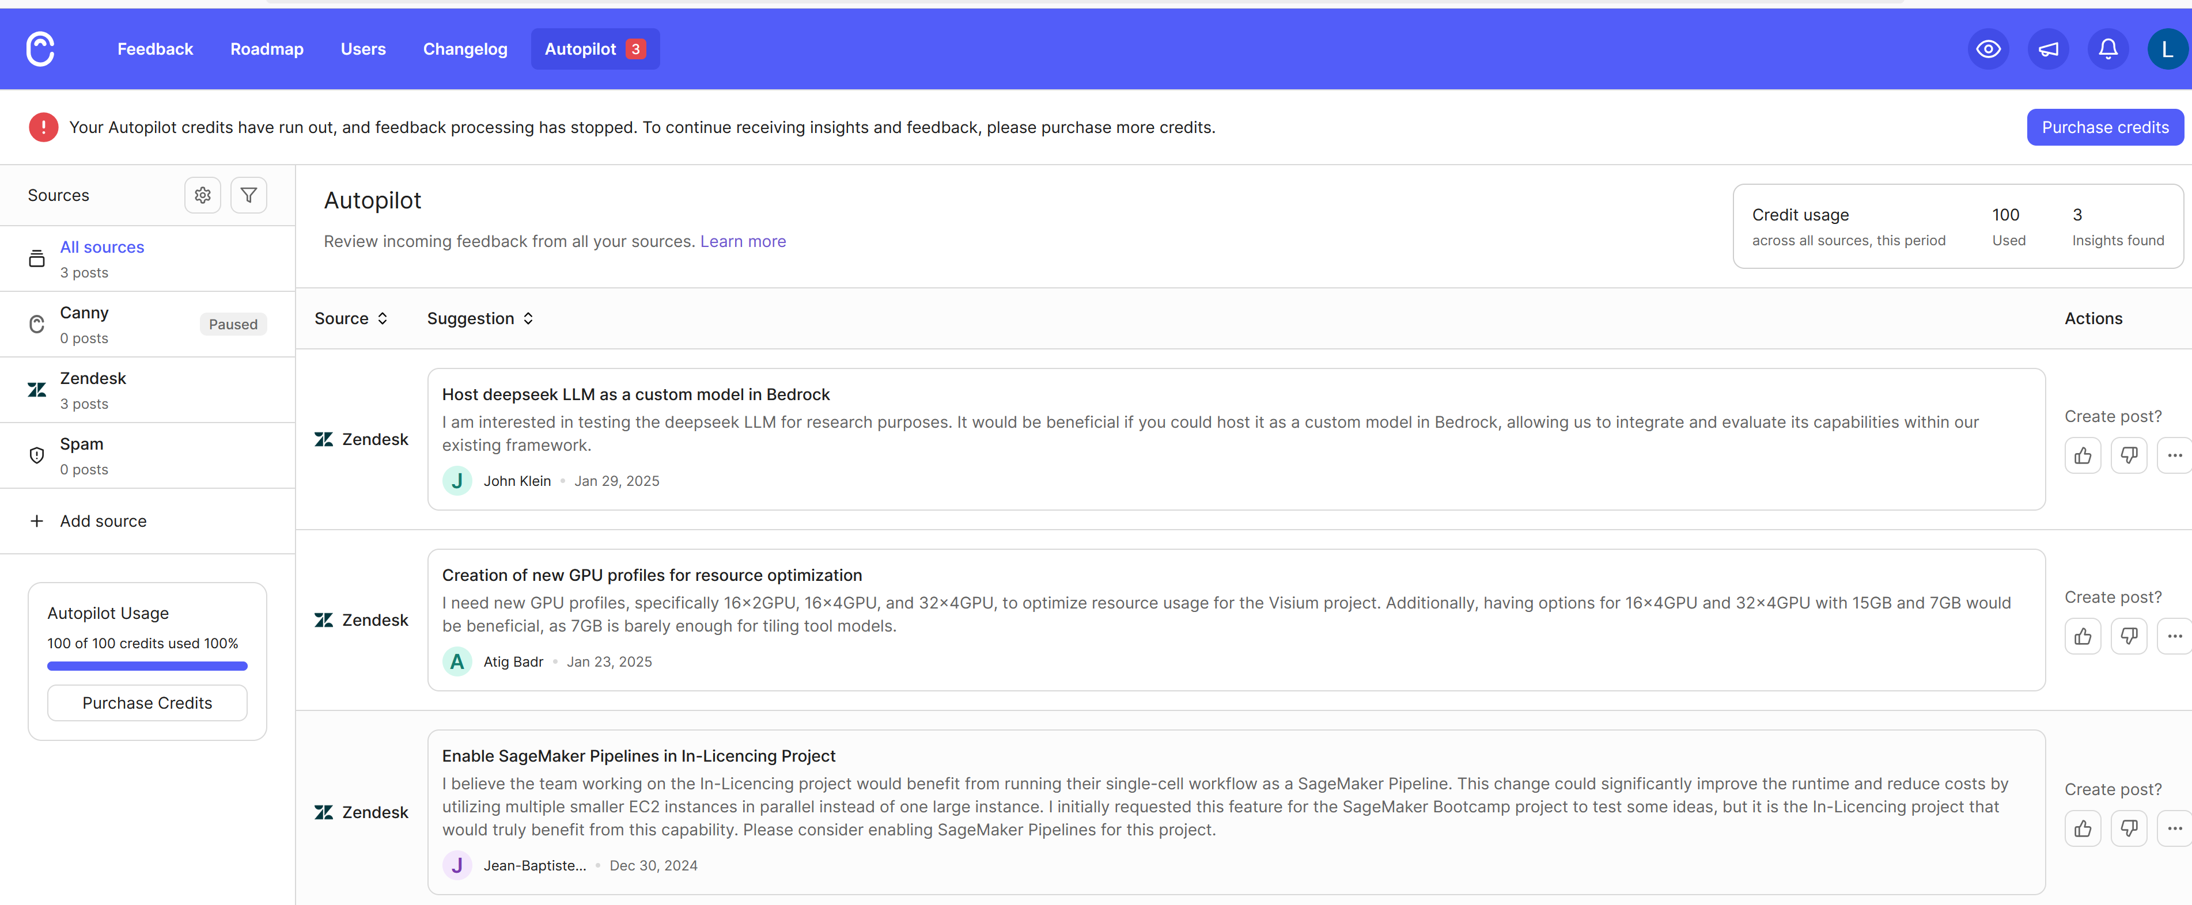
Introduction to Canny
Customer success: Weekly Support Report – 30.01.2025
What is Canny?
Canny is a feedback management tool that helps teams collect, organize, and prioritize user feedback.
It allows teams to see all feature requests in one place, making it easier to track what users need.
Helps product teams make data-driven decisions by analyzing feedback trends.

Slide 4
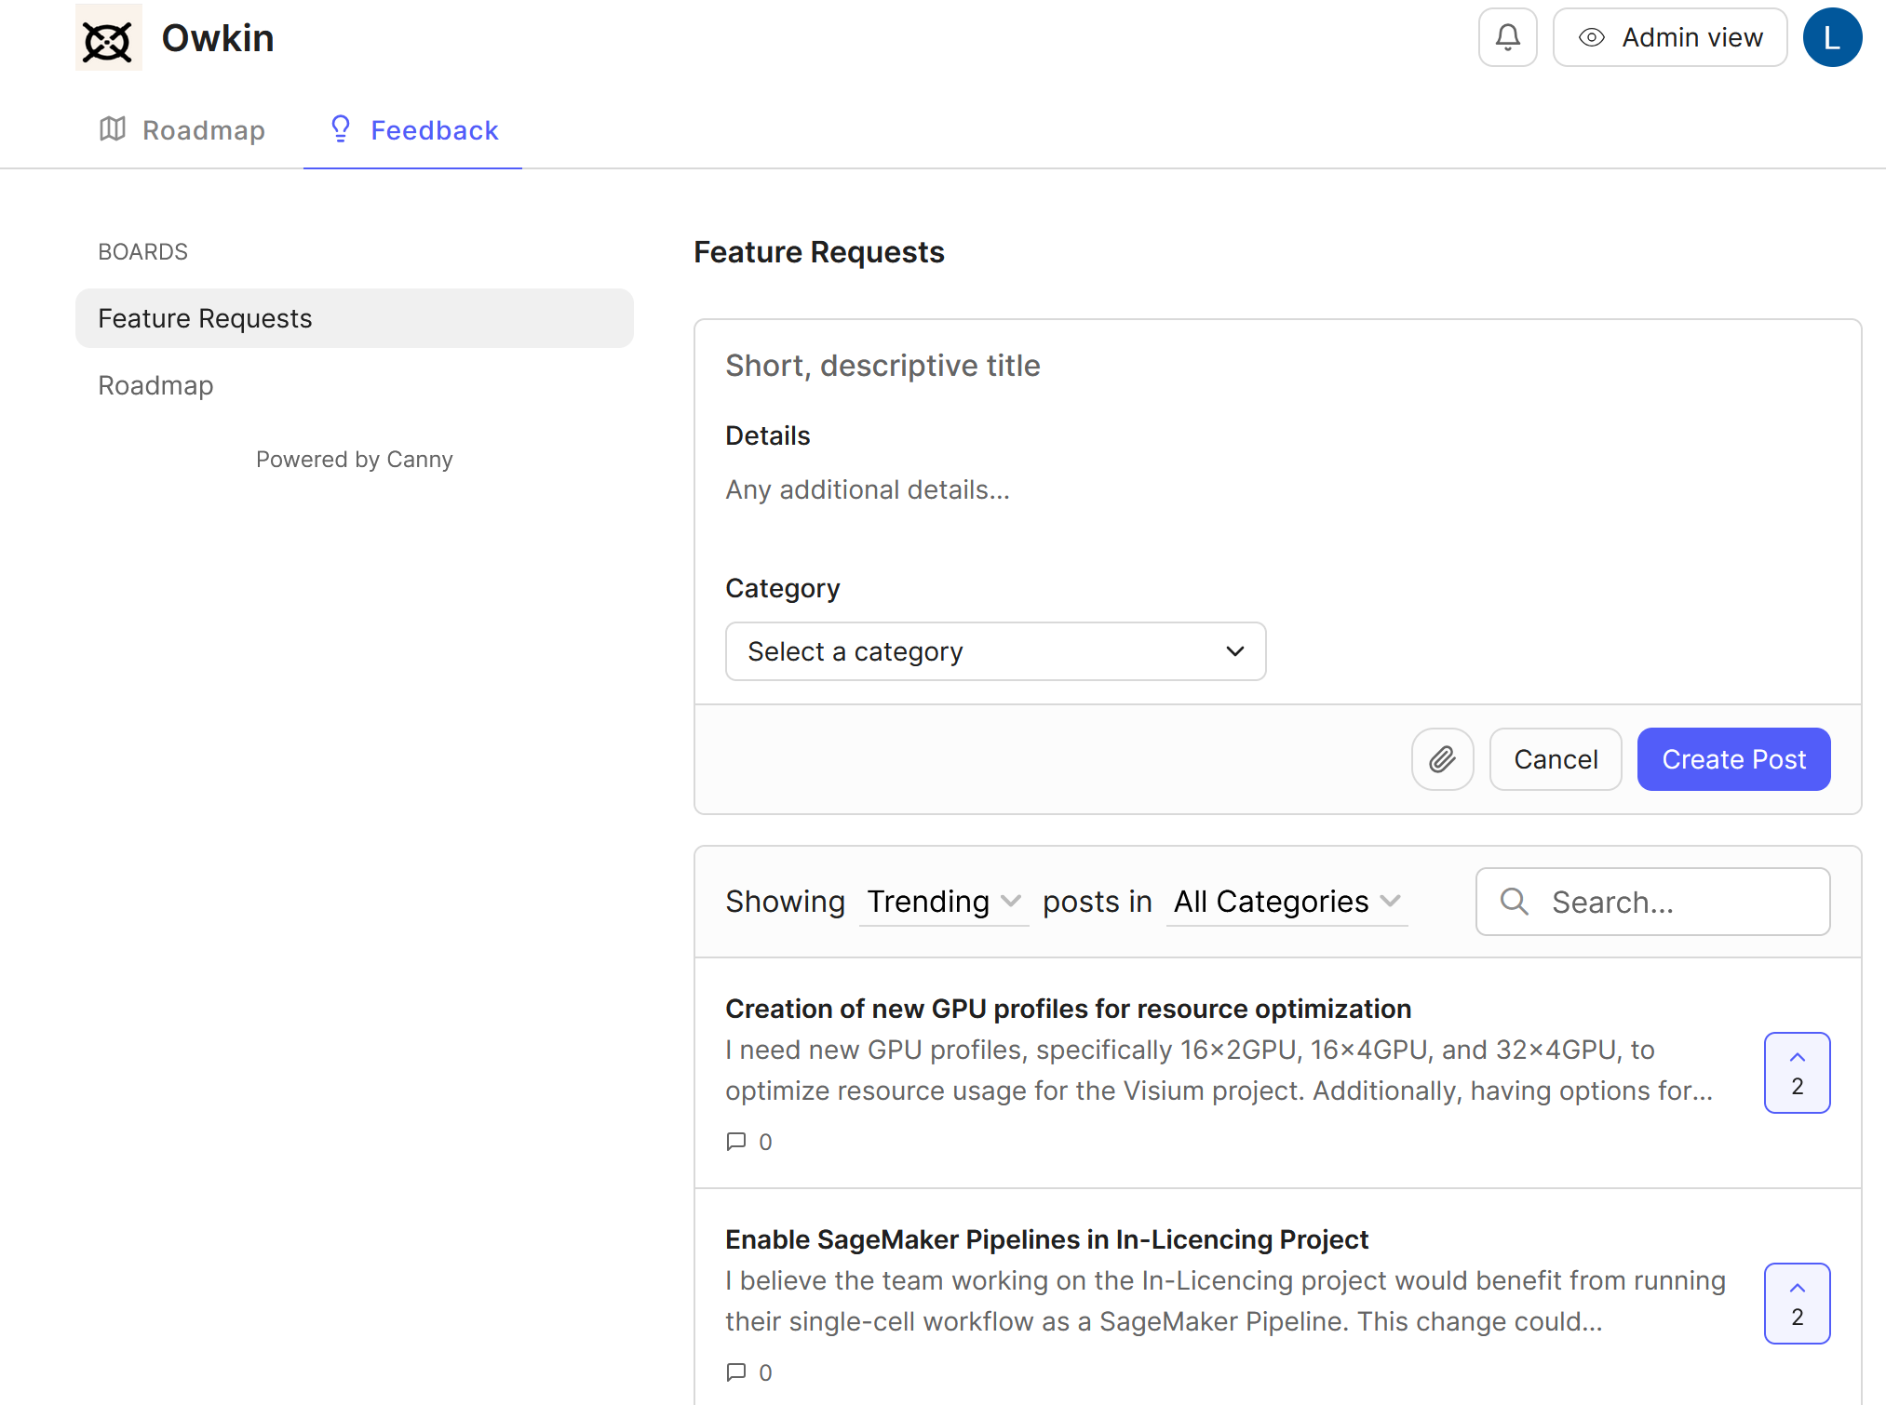
Why Canny for Owkin?
Customer success: Weekly Support Report – 30.01.2025
Why Should We Use Canny?
Centralized Feature requests: No more scattered requests from emails, Slack, or Zendesk. Everything in one place.
Prioritization with Voting: Users can vote on feature requests, helping us focus on the most wanted improvements.
Seamless Integration: Already integrated with Zendesk, allowing direct ticket-to-post conversions.
Transparency: Users can see request features and know what we are working on.

Slide 5
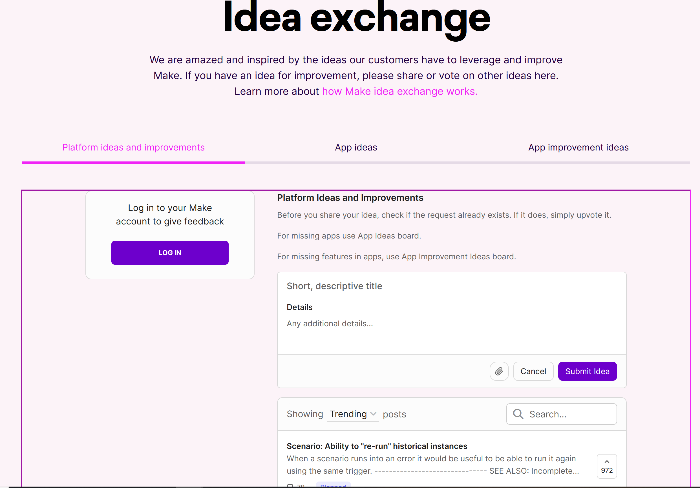
How We Can Use Canny
Customer success: Weekly Support Report – 30.01.2025
Canny’s Role in Our Workflow
Integration with Abstra Website: Embed Canny’s widget on our platform to collect structured feedback.
Sync with Zendesk: Any feature request submitted via Zendesk is automatically converted into a Canny post.
Organized Feature Requests: Team members can easily browse, track, and update requests within the Canny portal.
Internal Team Discussions: Leave internal comments on feedback posts to discuss solutions before implementation.

Slide 6
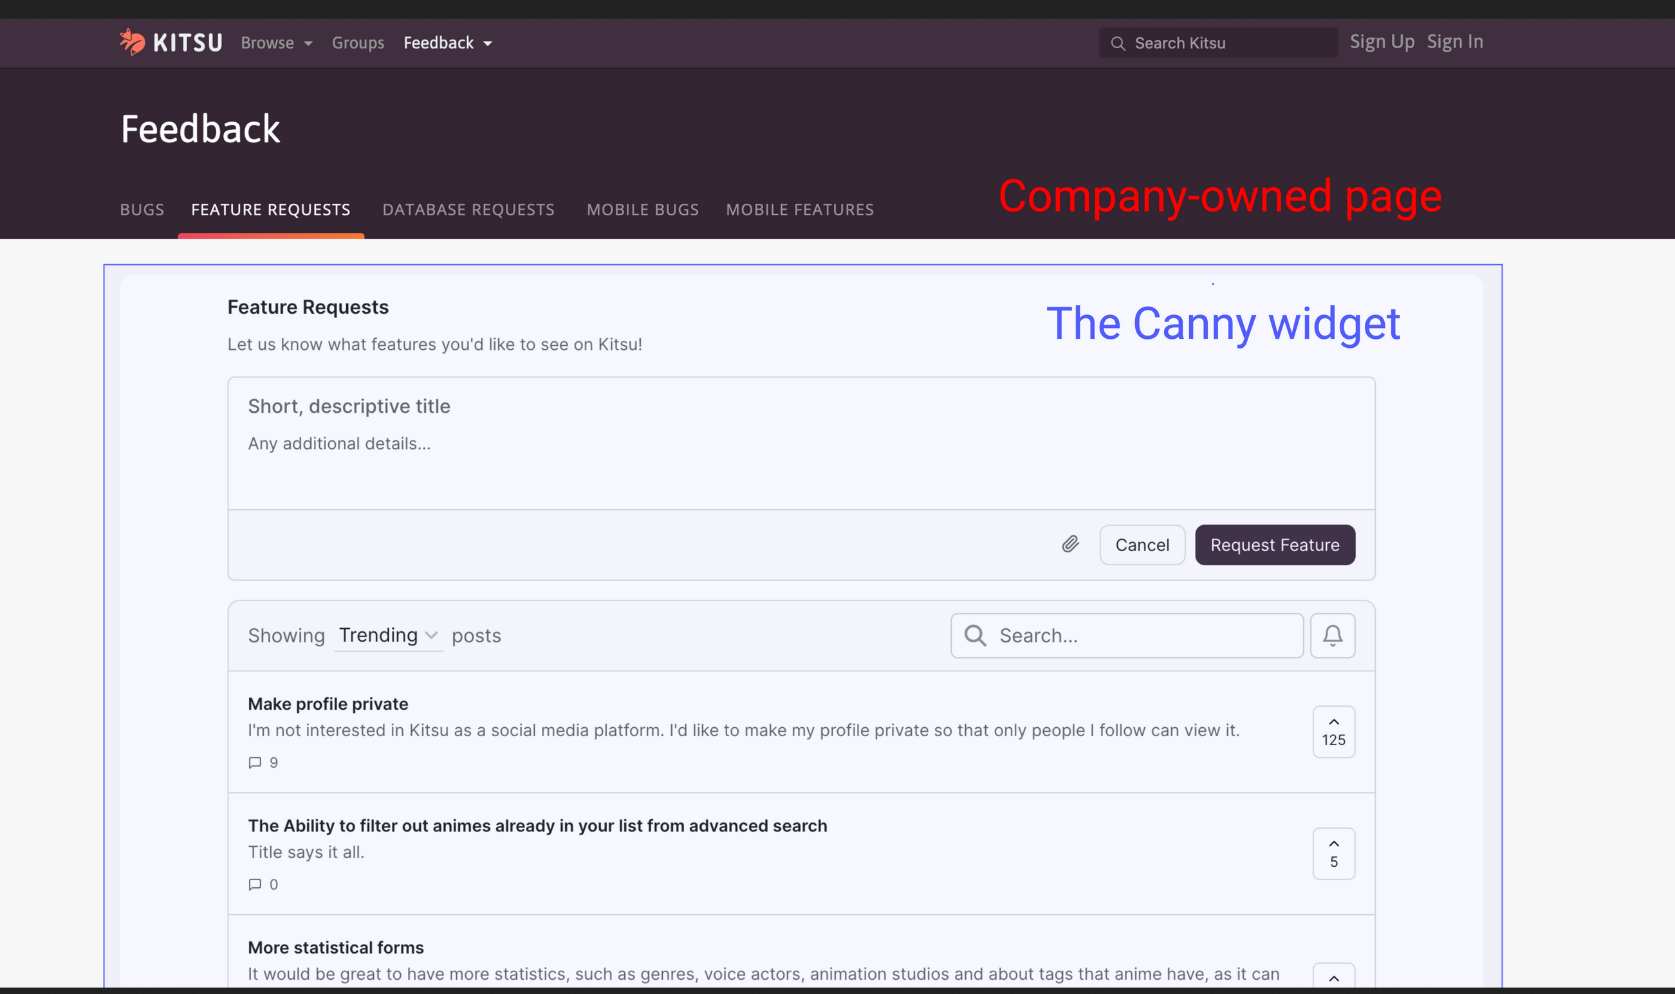
Understanding the Canny Portal
Customer success: Weekly Support Report – 30.01.2025
The Canny Portal: Where Feedback Lives
The Canny Portal is where all feedback is stored and managed.
Each post contains:
  Description of the request
  Upvotes from users
  Comments from both users and our team
  Status updates (Under Review, In Progress, Completed)
Helps us identify patterns and plan product improvements.
Example: A feature request for an AI-powered data visualization tool gets 30 upvotes. This tells us it’s a high-priority improvement.

Slide 7
Key Benefits for the Product Team
Customer success: Weekly Support Report – 30.01.2025
How Our Product Team Benefits
Better Product Decisions: Data-driven prioritization rather than guesswork.
Reduced Support Overload: Users can track progress, reducing repetitive requests.
Improved Collaboration: Engineers, designers, and PMs can discuss requests directly in Canny.
User Engagement: Customers feel heard, increasing their satisfaction.
Example: If we notice a trend in feedback about usability issues, we can quickly respond with UX improvements.

Slide 8
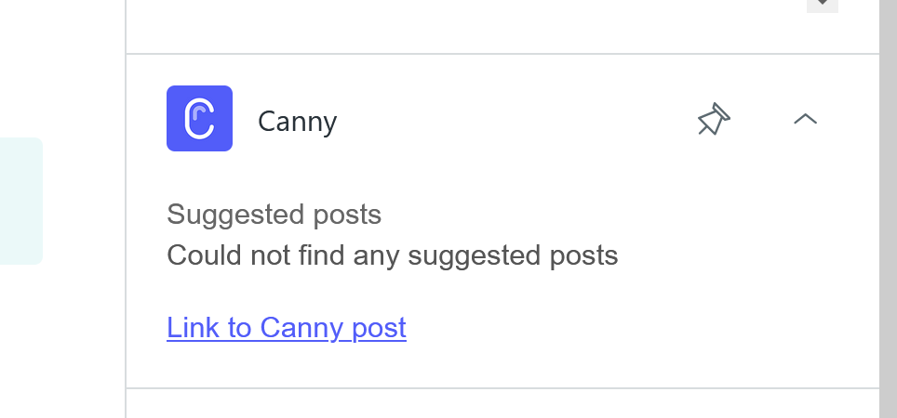
Conclusion
Customer success: Weekly Support Report – 30.01.2025
Canny as a Strategic Tool for Owkin
Canny helps us listen, analyze, and act on user feedback efficiently.
It enables a transparent, structured, and scalable way to improve our product.
By integrating Canny into our workflow, we ensure that the most impactful features get built.

Slide 9

Q&A
Customer success: Weekly Support Report – 30.01.2025

Slide 10
Thank you!

